Slide 1
Web Programming Project 1
Group Members:
Sang Kim, Hyunki Lee,
Jacob Wilson, Tin Huynh

Slide 2
Assigned Work
Group Leader: Jacob Wilson - developed main poker page, ppt, developed info page, alignment of players and cards, card animation, table setup in html and css, debugging, helped with diagrams
Developer/QA: Tin Huynh - login developed the page animations and also the game board loading animations, combined separate completed segments of code from other members, testing syntax online
Developer/QA: Danny Kim: developed login page and helped design backgrounds of both pages, finalize setup poker table/login page and its images, powerpoint
Developer/QA: Huynki Lee: designed class diagrams, worked on finalizing styles and better imaging for html files, testing and debugging for errors
In this project we developed a shell of a poker game and added animations/transitions to make it a good user experience and compensate for it not being playable.

Slide 3
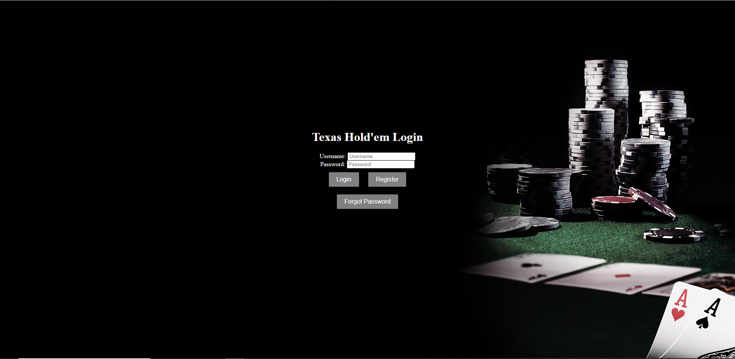
Login Page (index.html)

Slide 4
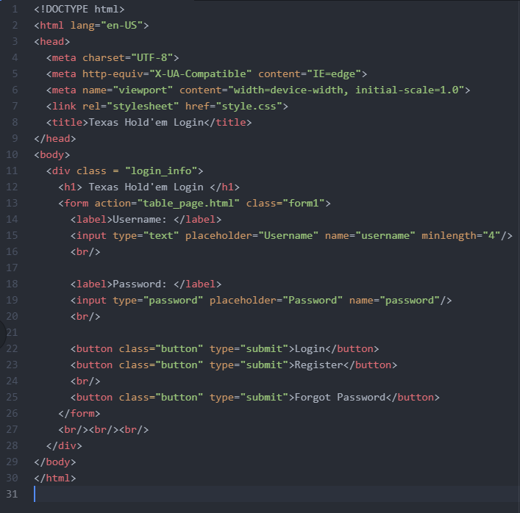
Login Page (Code)

Slide 5
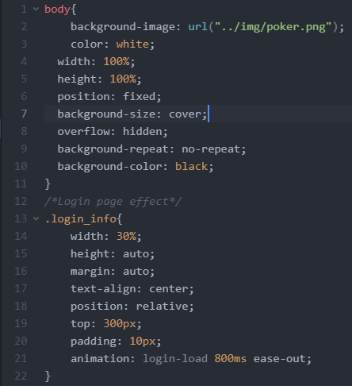
Login Page (CSS)

Slide 6
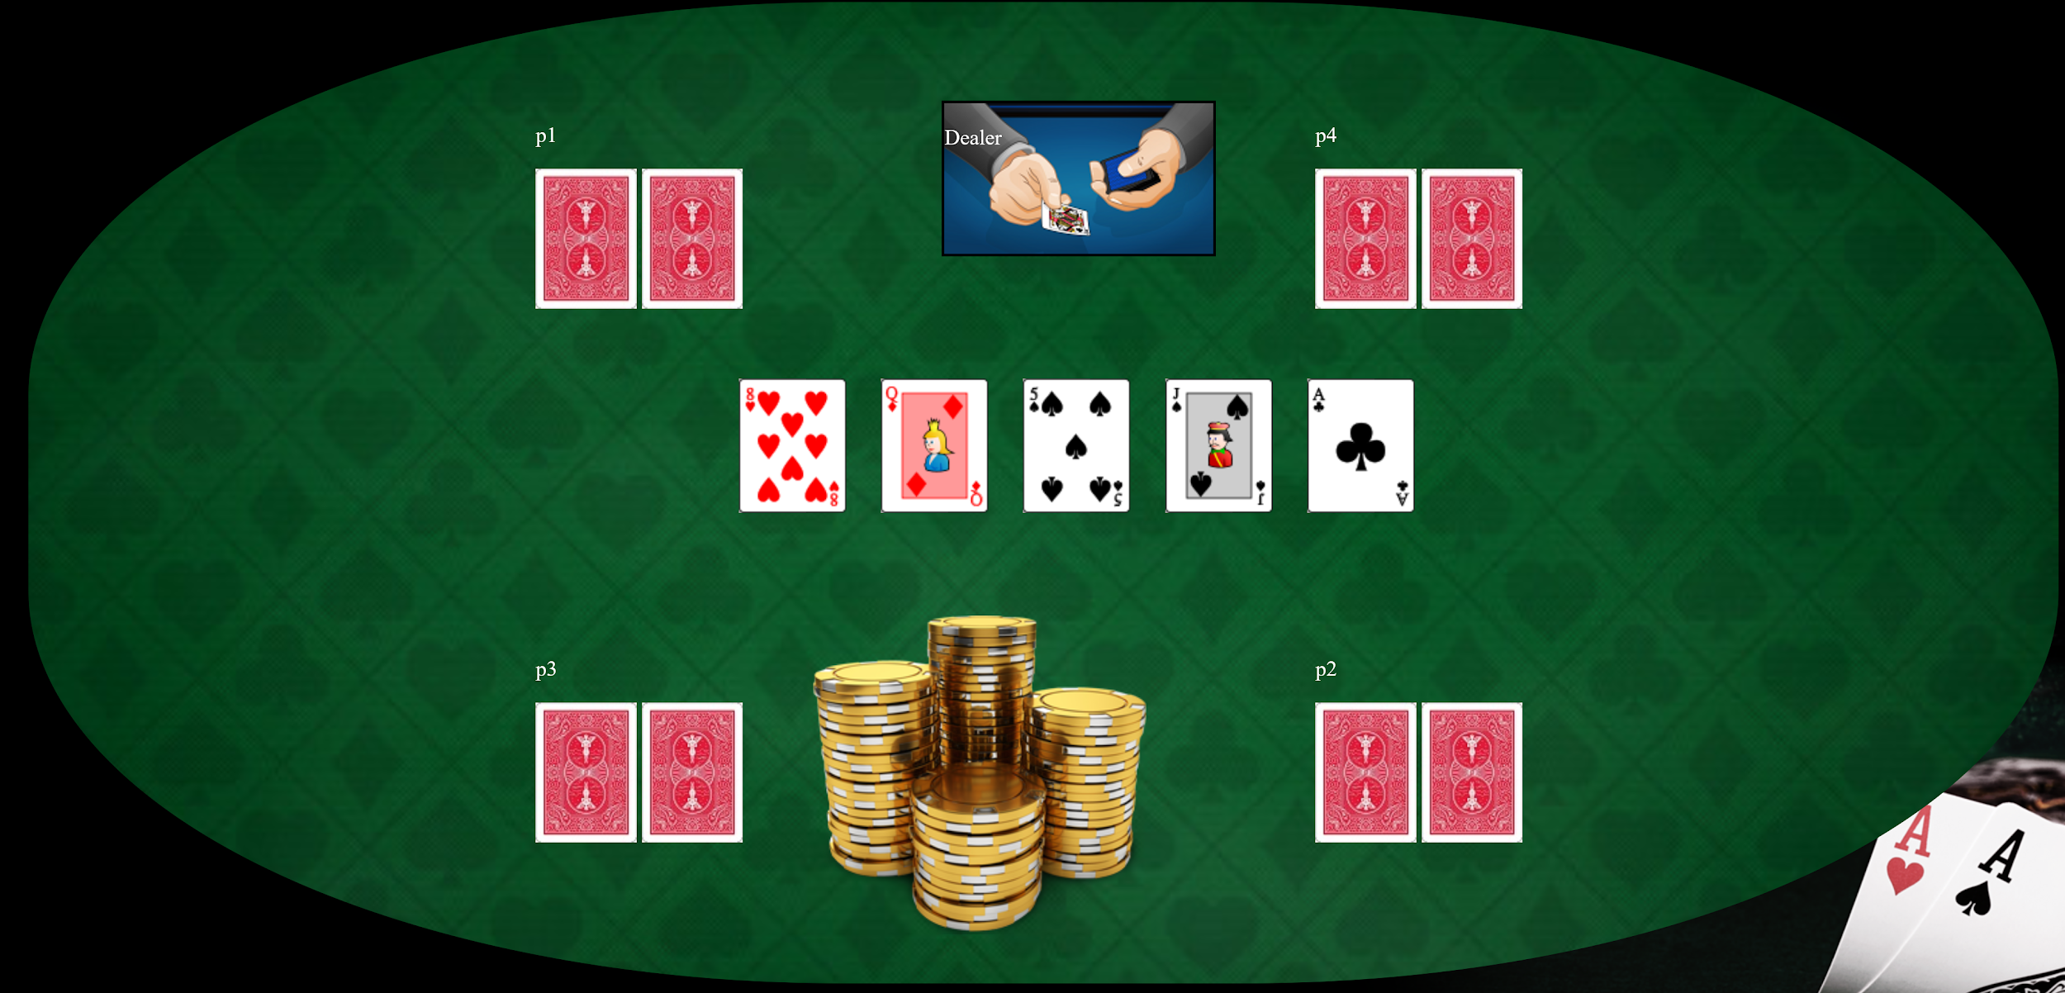
Main table

Slide 7
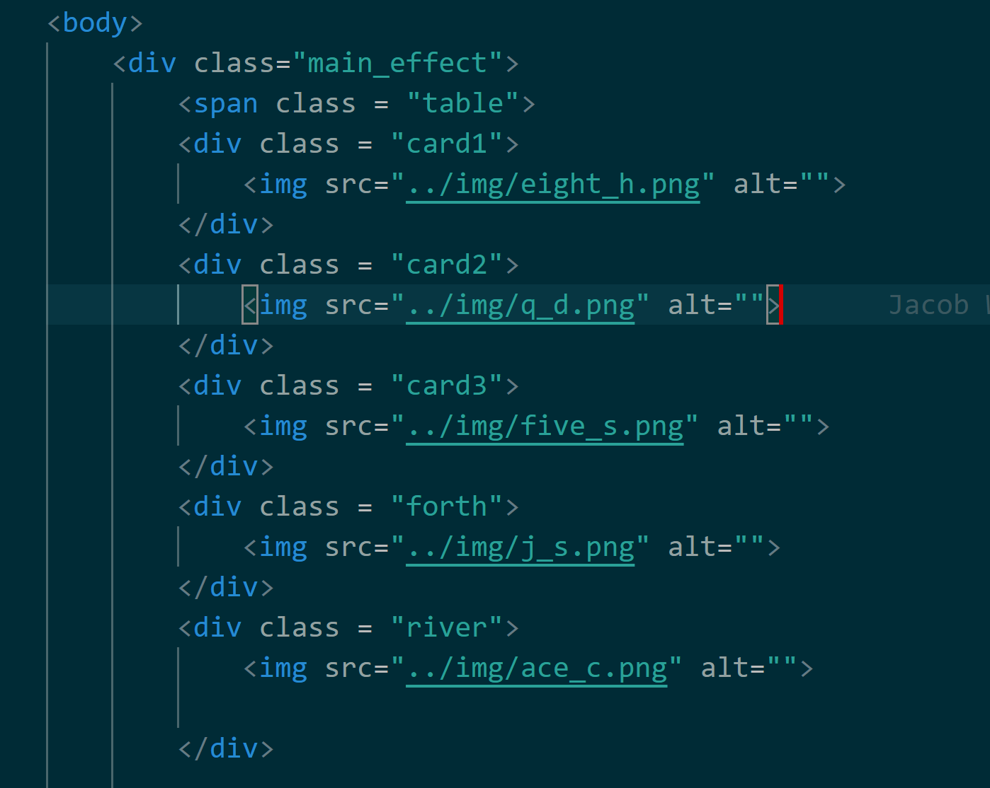
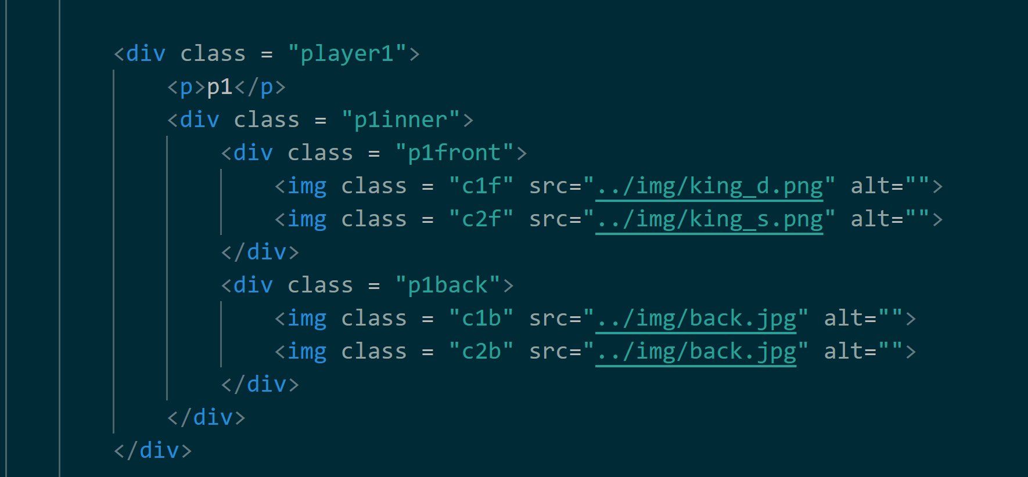
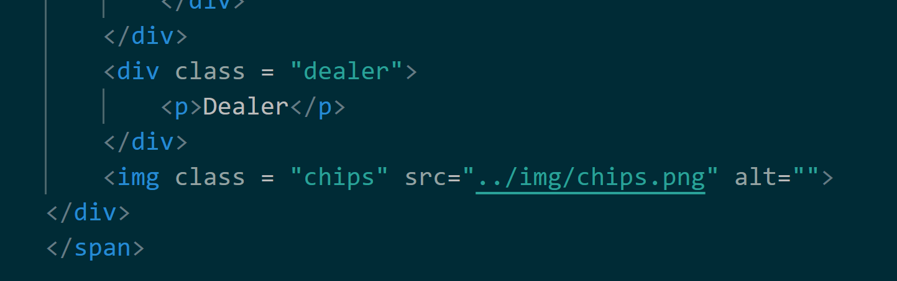
Html for main table
Notes:
Anchor everything to main table span container.
Individual divs for each community card;
Players have player_n container with inner container that has front/back of card
Players feature similar design in html..

Slide 8
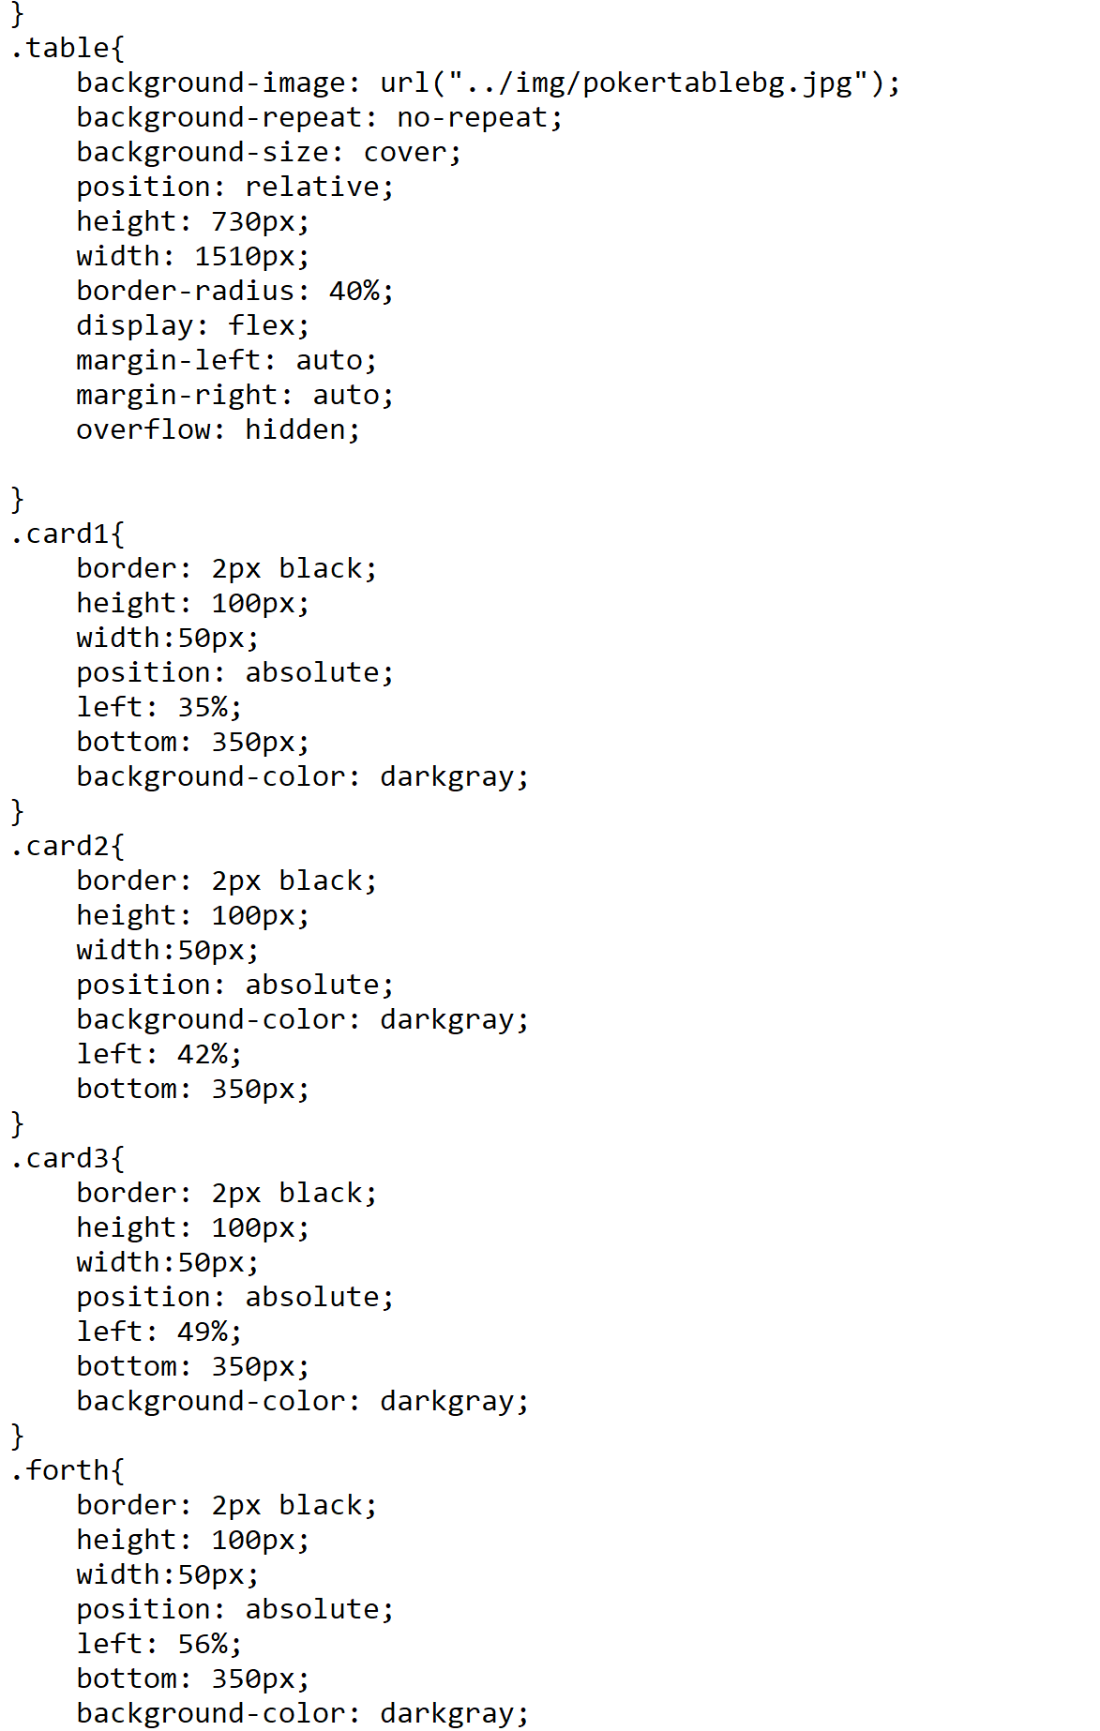
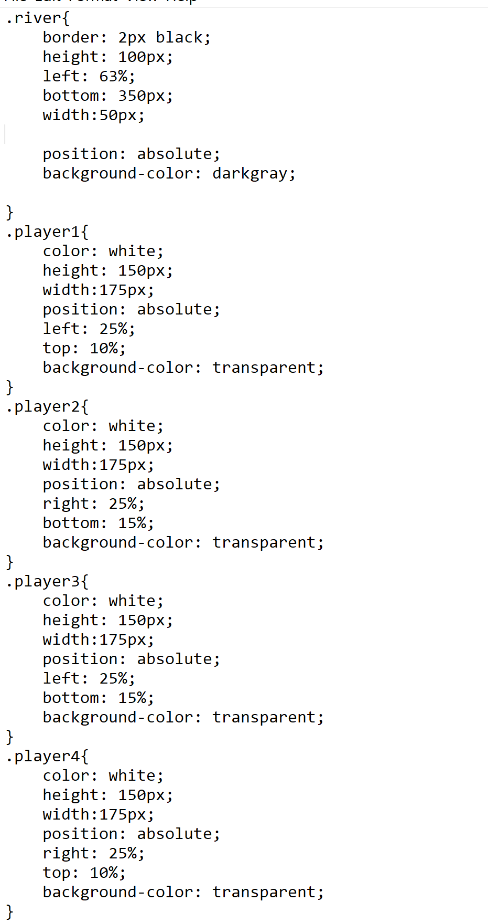
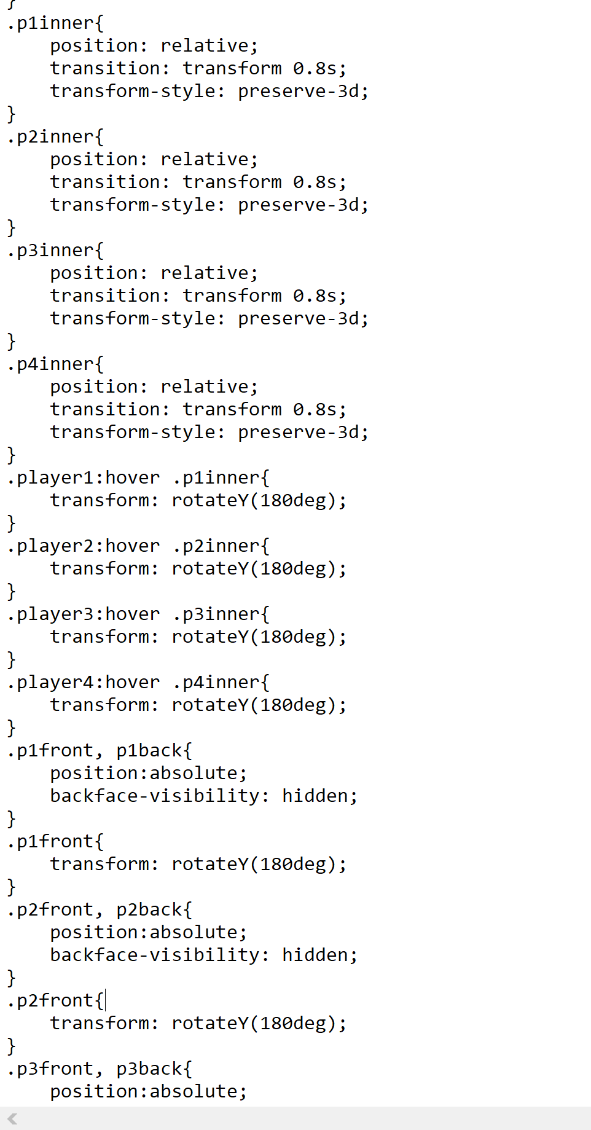
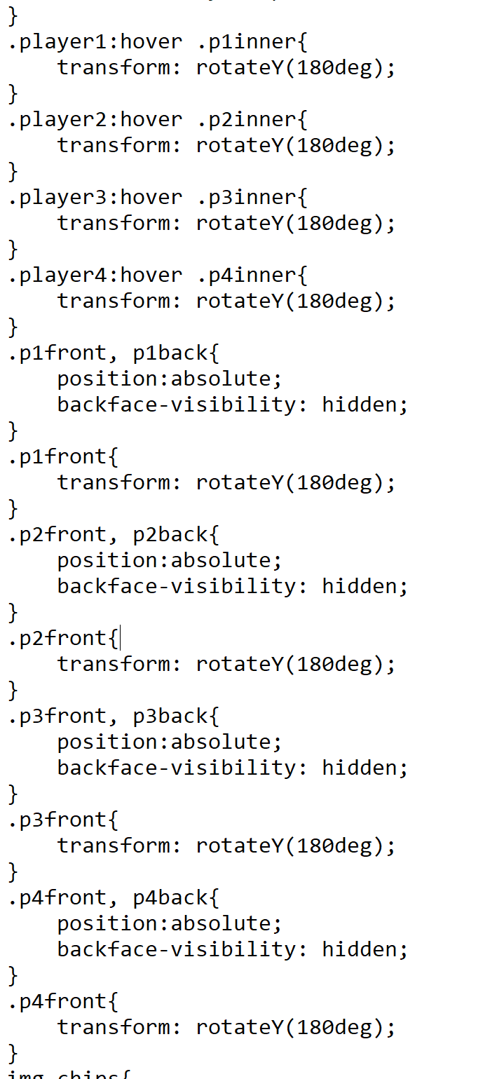
Css for main table & positioning of players/cards
Notes:
Anchor everything to main table tag(Keep inside table);
Use containers for players and do nested divs for card transform(rotatey)
Use absolute positioning for players and their ards. Relative for inner divs

Slide 9
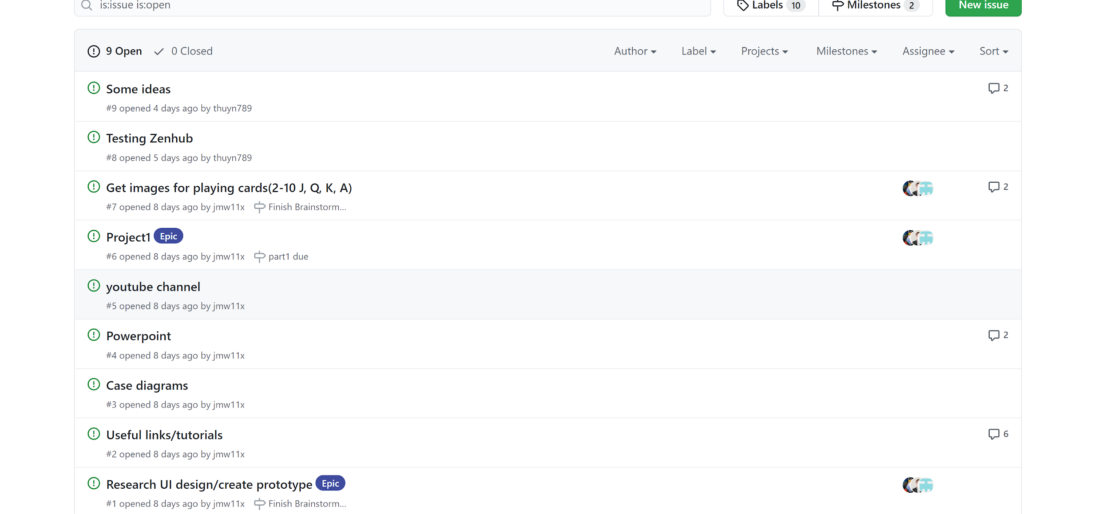
Communication through Github Discord and Zenhub

Slide 10
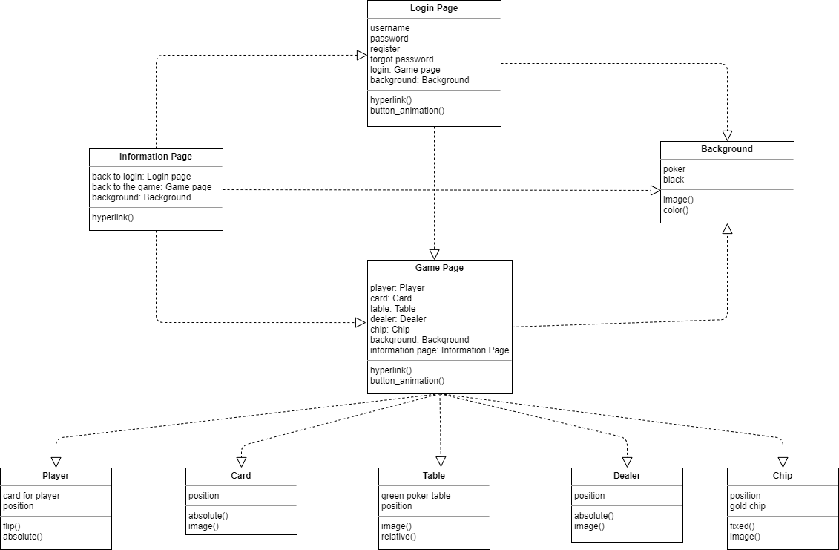
Class Diagram

Slide 11

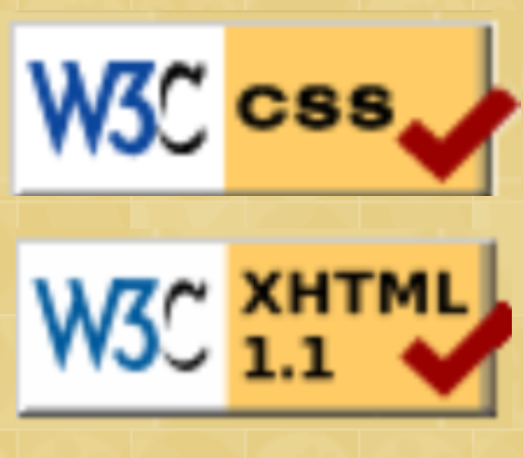
Testing and Debugging
Used w3c to test if tests passed as in previous assignments
Met as group to debug as issues aries
Ex;
Positioning was off on table page. Found it was a span tag was not closed in right place
Used firefox dev edition tools to find
Using github/discord meetings to synchronize all bits of code together pushed by different group members
Notes:
Include pictures of pass test/ some discussion about how we debug positioning.

Slide 12
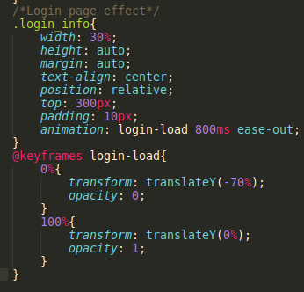
Login Page Animation
Source: CSS @keyframes Rule - https://www.w3schools.com/cssref/css3_pr_animation-keyframes.asp

Slide 13
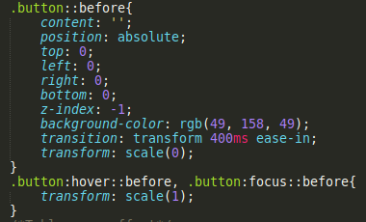
Button Effect
Source: Web Dev Simplified - https://www.youtube.com/watch?v=cH0TC9gWiAg
CSS ::before Selector - https://www.w3schools.com/cssref/sel_before.asp

Slide 14
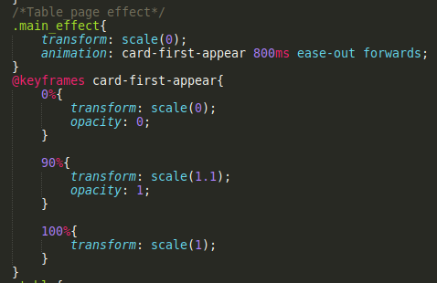
Main Table Animation
Source: CSS @keyframes Rule - https://www.w3schools.com/cssref/css3_pr_animation-keyframes.asp

Slide 15
Demo of page..

